Slide 1
Querying structured data with LLMs
in a systematic way
Michał Pstrąg

Slide 2

Michał Pstrąg
Machine Learning Engineer at deepsense.ai
Area of focus: Retrieval Systems, Generative Models
Previous experience: Software Engineer at Nokia
My socials: linktr.ee/micpst

Slide 3
Before we start
Querying structured data with LLMs
in a systematic way
Structured data → Relational databases → SQL
LLMs → Generative Models → Probabilistic Algorithms → Mess

Slide 4
Why?

Slide 5
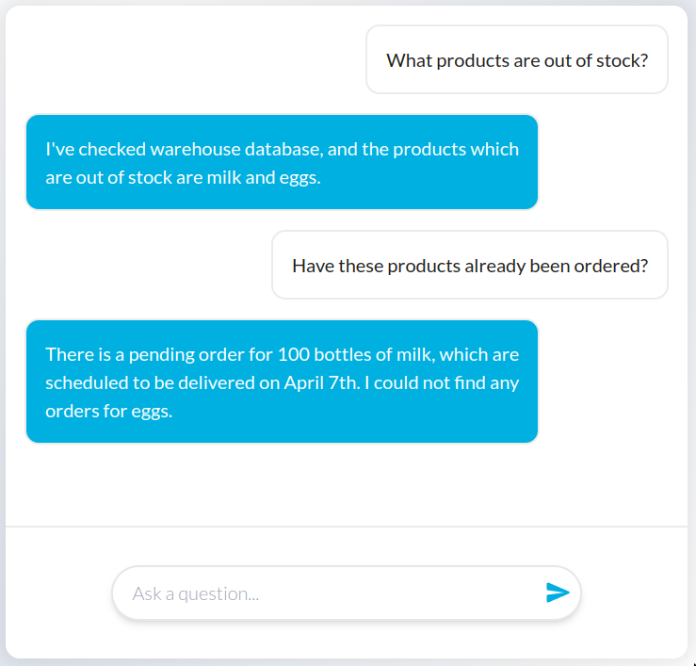
We want to build
AI assistant chatbot.
Answers employee questions based on the enterprise database.
We want to use a large language model.

Slide 6
How?

Slide 7


Architectures
Model only
Retrieval-Augmented Generation

Slide 8
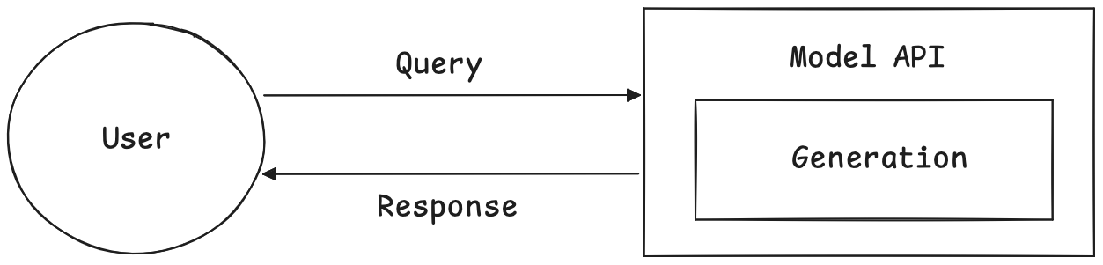
Model only

Slide 9
Model only
Dependence on the internal knowledge of the model.
Unreliable due to training data and methodology.
High probability of hallucinations.

Slide 10
Smarter way - RAG
Research has shown that access to relevant contextual information can significantly help the model generate more detailed responses while reducing hallucinations (Lewis et al., 2020).
Retrieval-Augmented Generation for Knowledge-Intensive NLP Tasks
arxiv.org/abs/2005.11401

Slide 11
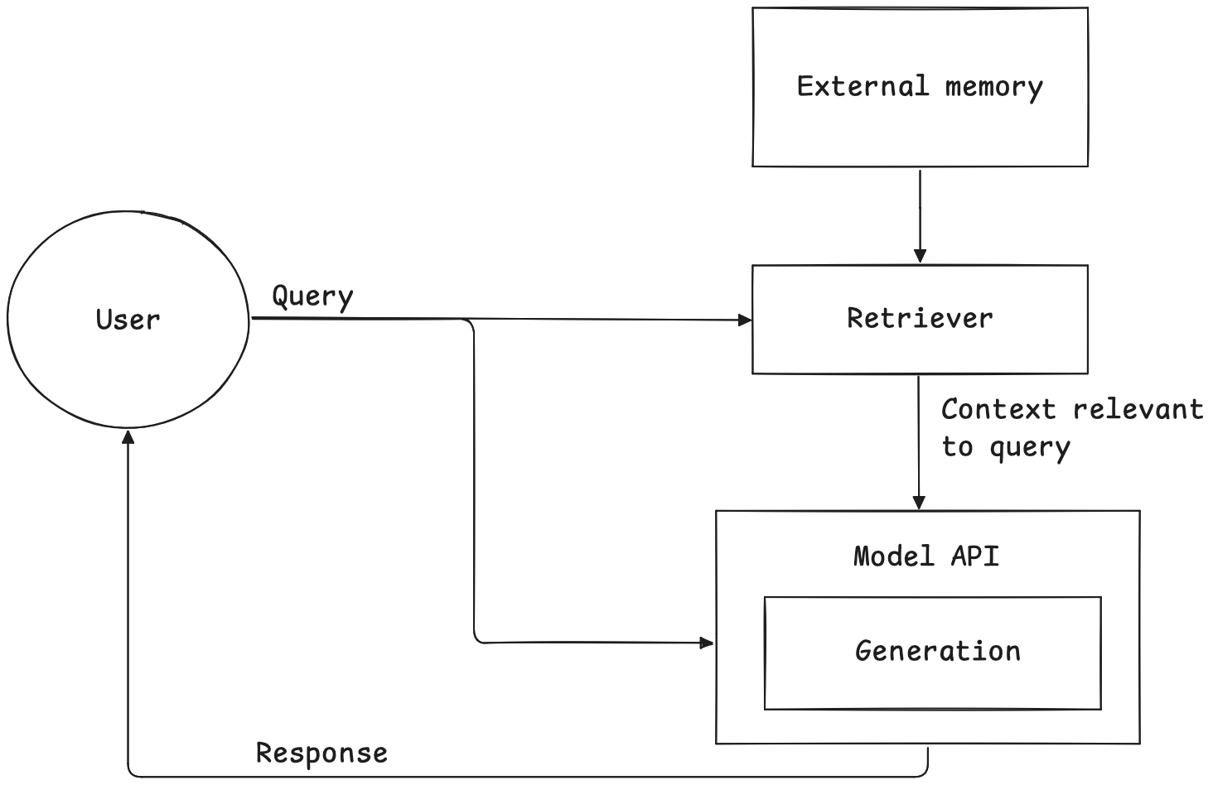
Retrieval-Augmented Generation

Slide 12
Retrieval-Augmented Generation
Retrieval is not unique to RAG.
It is the basis of search engines, recommendation systems, etc.
Search algorithms developed for traditional systems can be used in RAG.
Can be applied to structured and unstructured data.

Slide 13
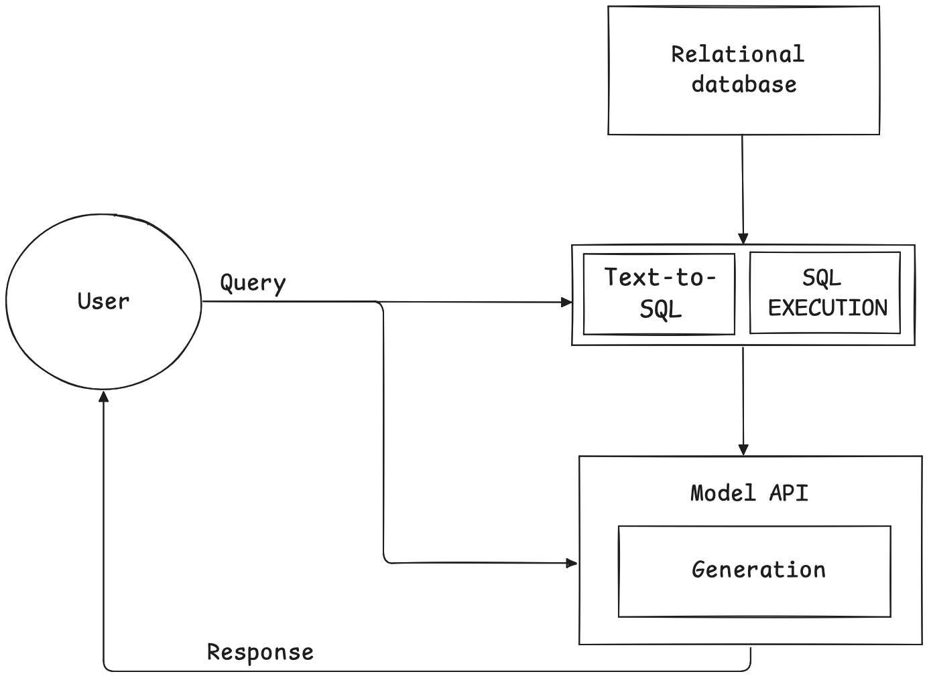
RAG for tabular data

Slide 14
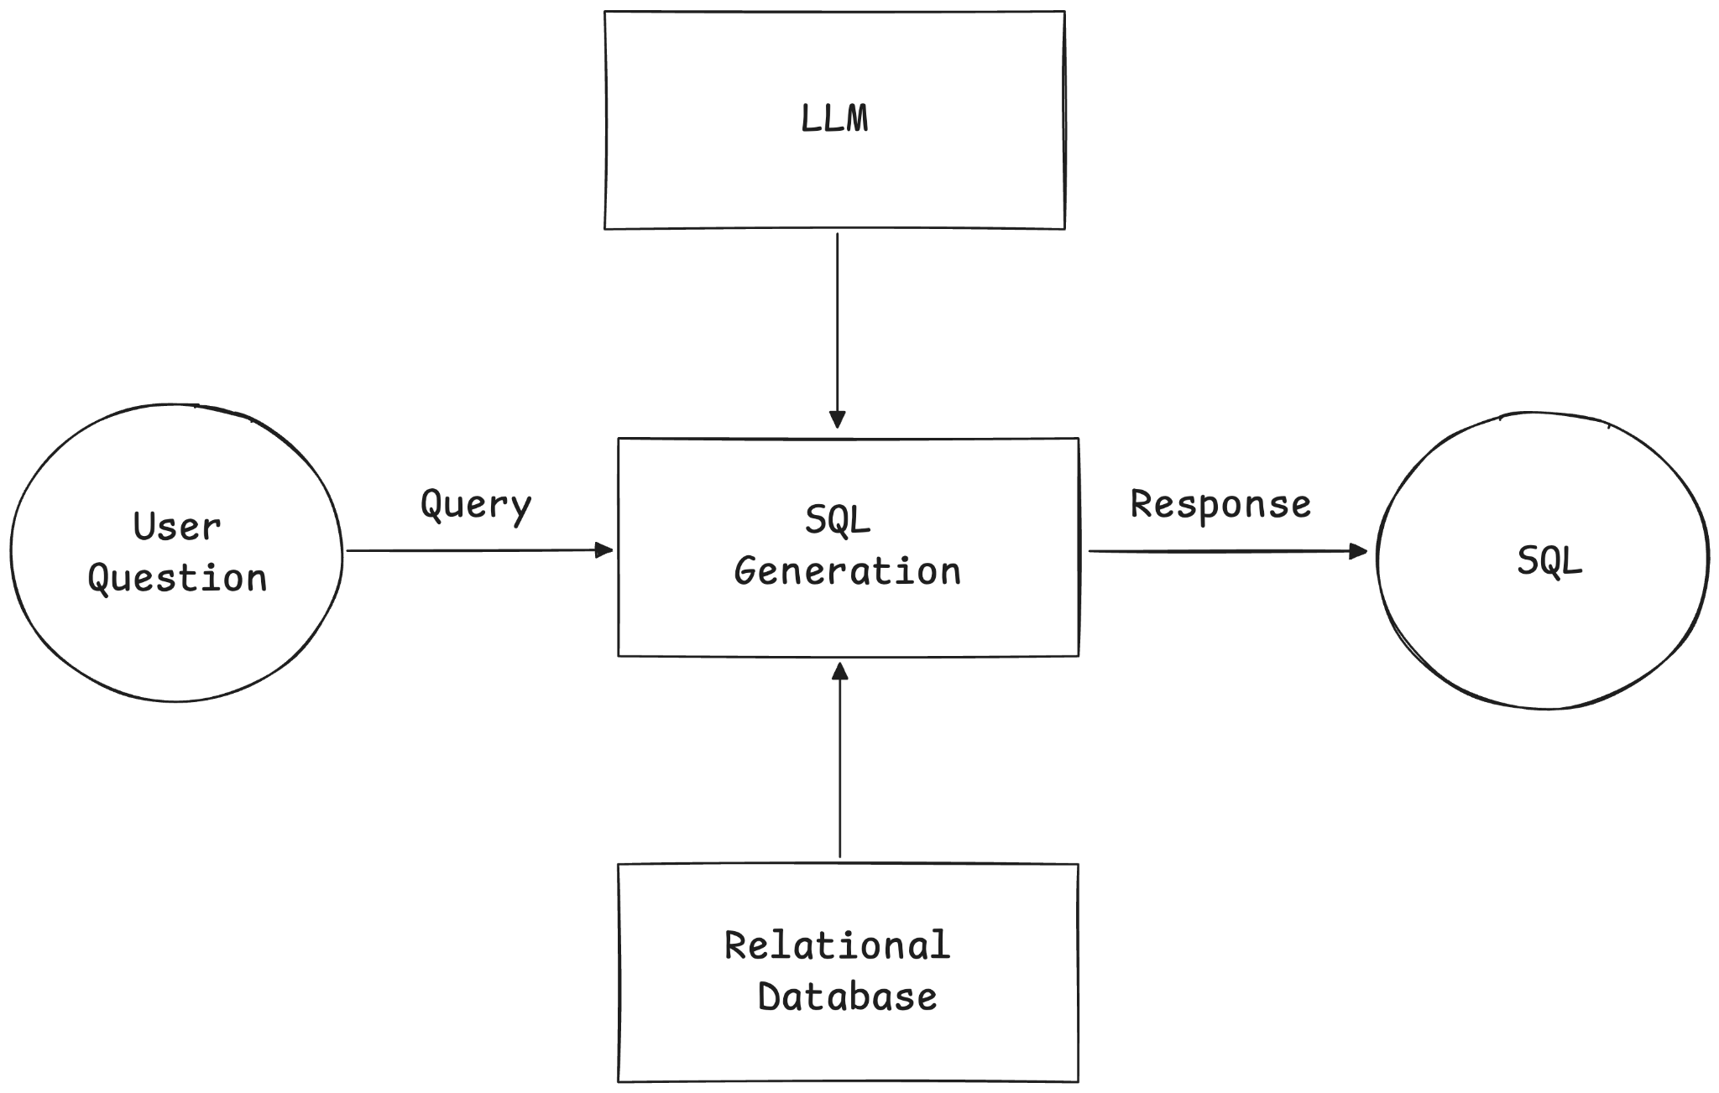
Text-to-SQL

Slide 15
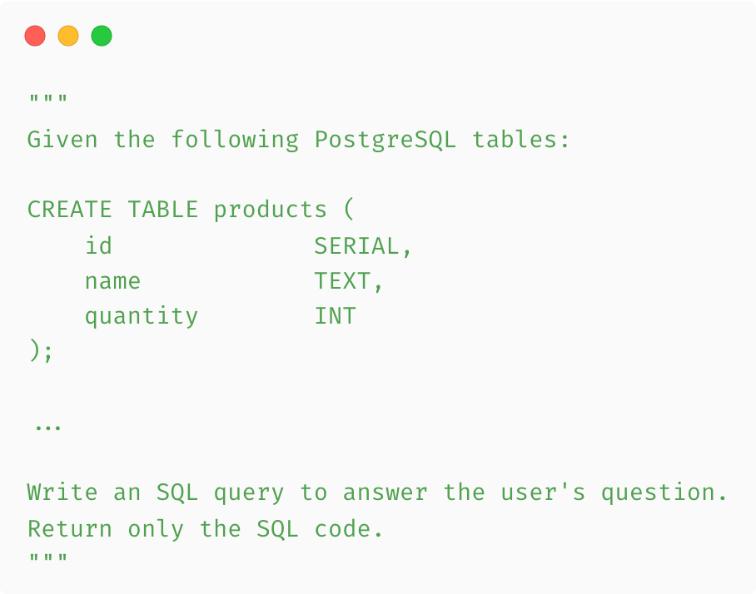
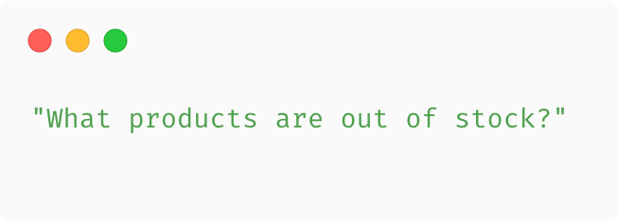
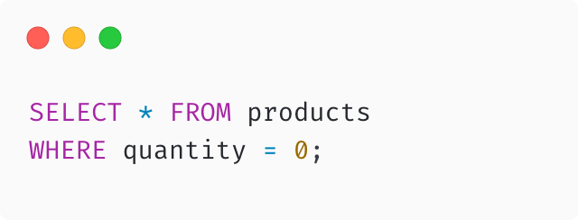
Text-to-SQL
SYSTEM
USER
ASSISTANT

Slide 16
Problems

Slide 17
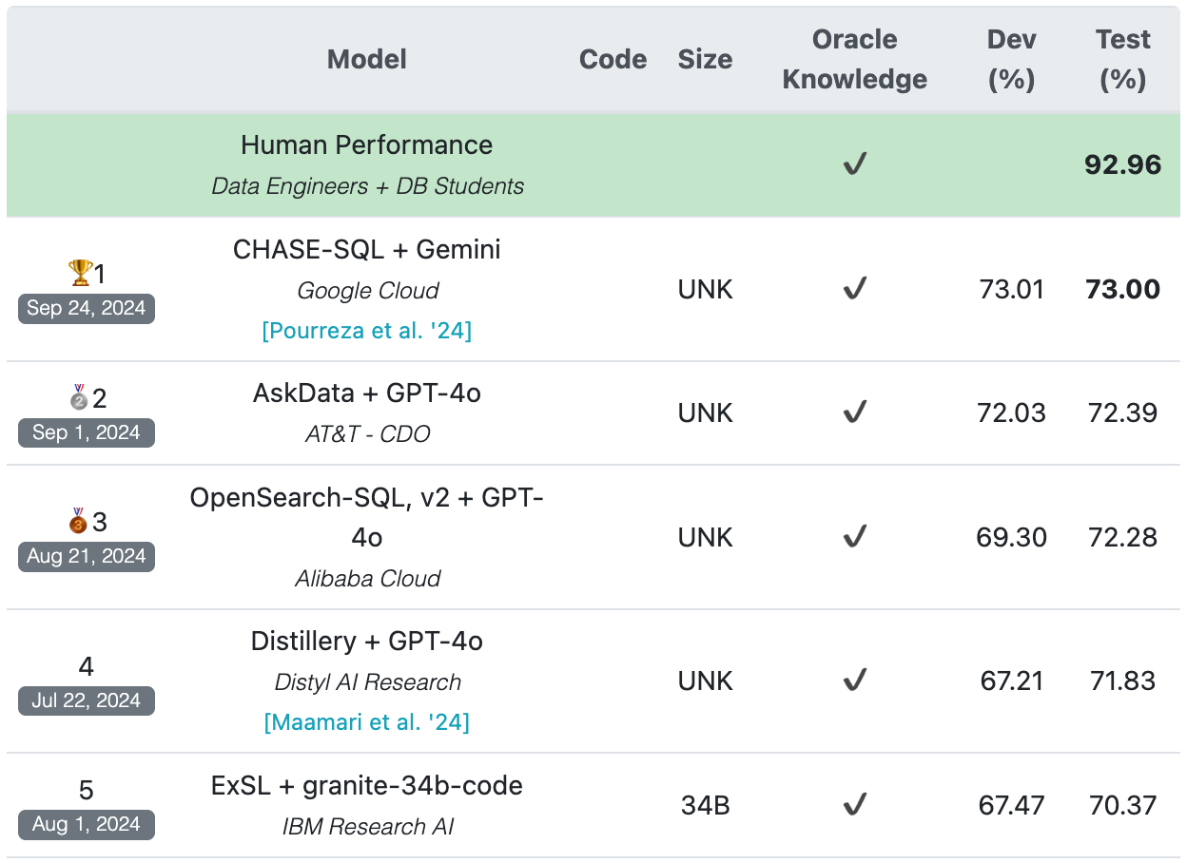
Incorrect SQL generation
BIRD top ranking provides only 73% accuracy.
The baseline GPT-4 achieved 55% on the same benchmark.
After optimization, the results are still not satisfactory.
bird-bench.github.io [19.10.2024]

Slide 18
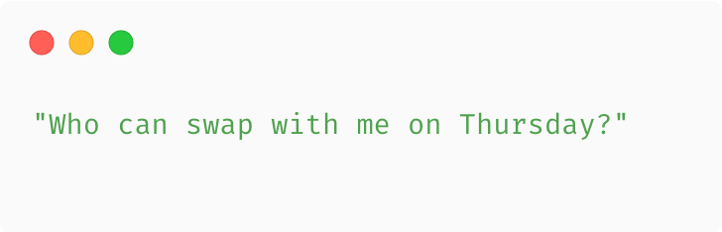
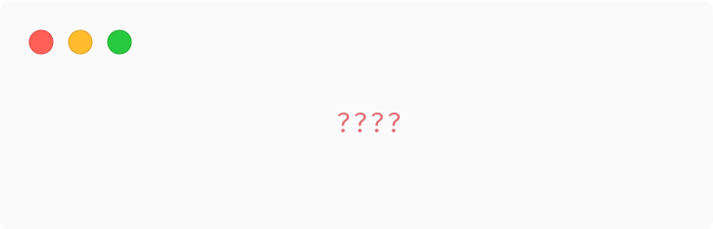
Lack of domain knowledge
Domain knowledge can be very problematic for LLMs.
Sometimes additional retrieval is required to help the model answer the question.
It may be necessary to hardcode some business logic in the prompt, which is not elegant.
USER
ASSISTANT

Slide 19
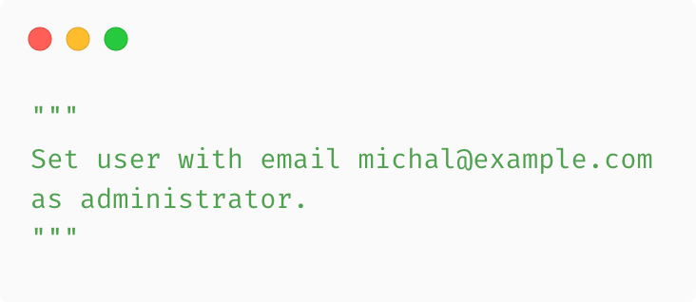
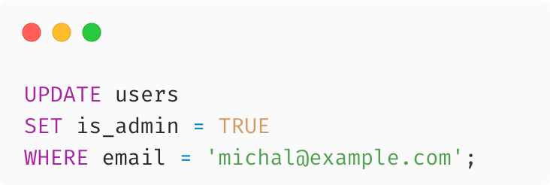
Risk of data modification
The account the LLM uses should have the lowest possible permissions.
Allow only for SELECT statements.
Limit the tables that it has access to.
Often requires the creation of dedicated views for the LLM with limited columns and enforced filters.
Requires proper monitoring of the prompts and model responses sent.
USER
ASSISTANT

Slide 20
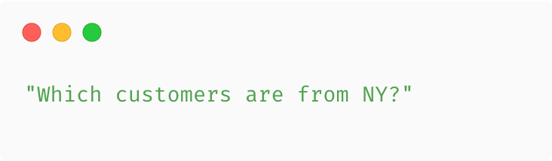
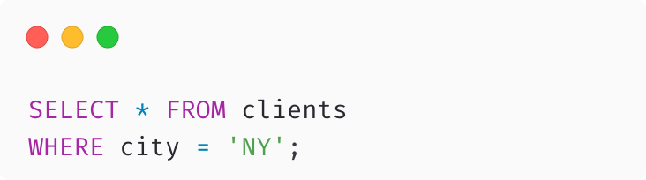
Constants in the query
NY ≠ New York
USER
id | client_name | city
1 | Bob | New York
2 | Katie | Detroit
3 | Monica | Los Angeles
4 | Joey | New York
5 | Alice | Washington DC
ASSISTANT

Slide 21
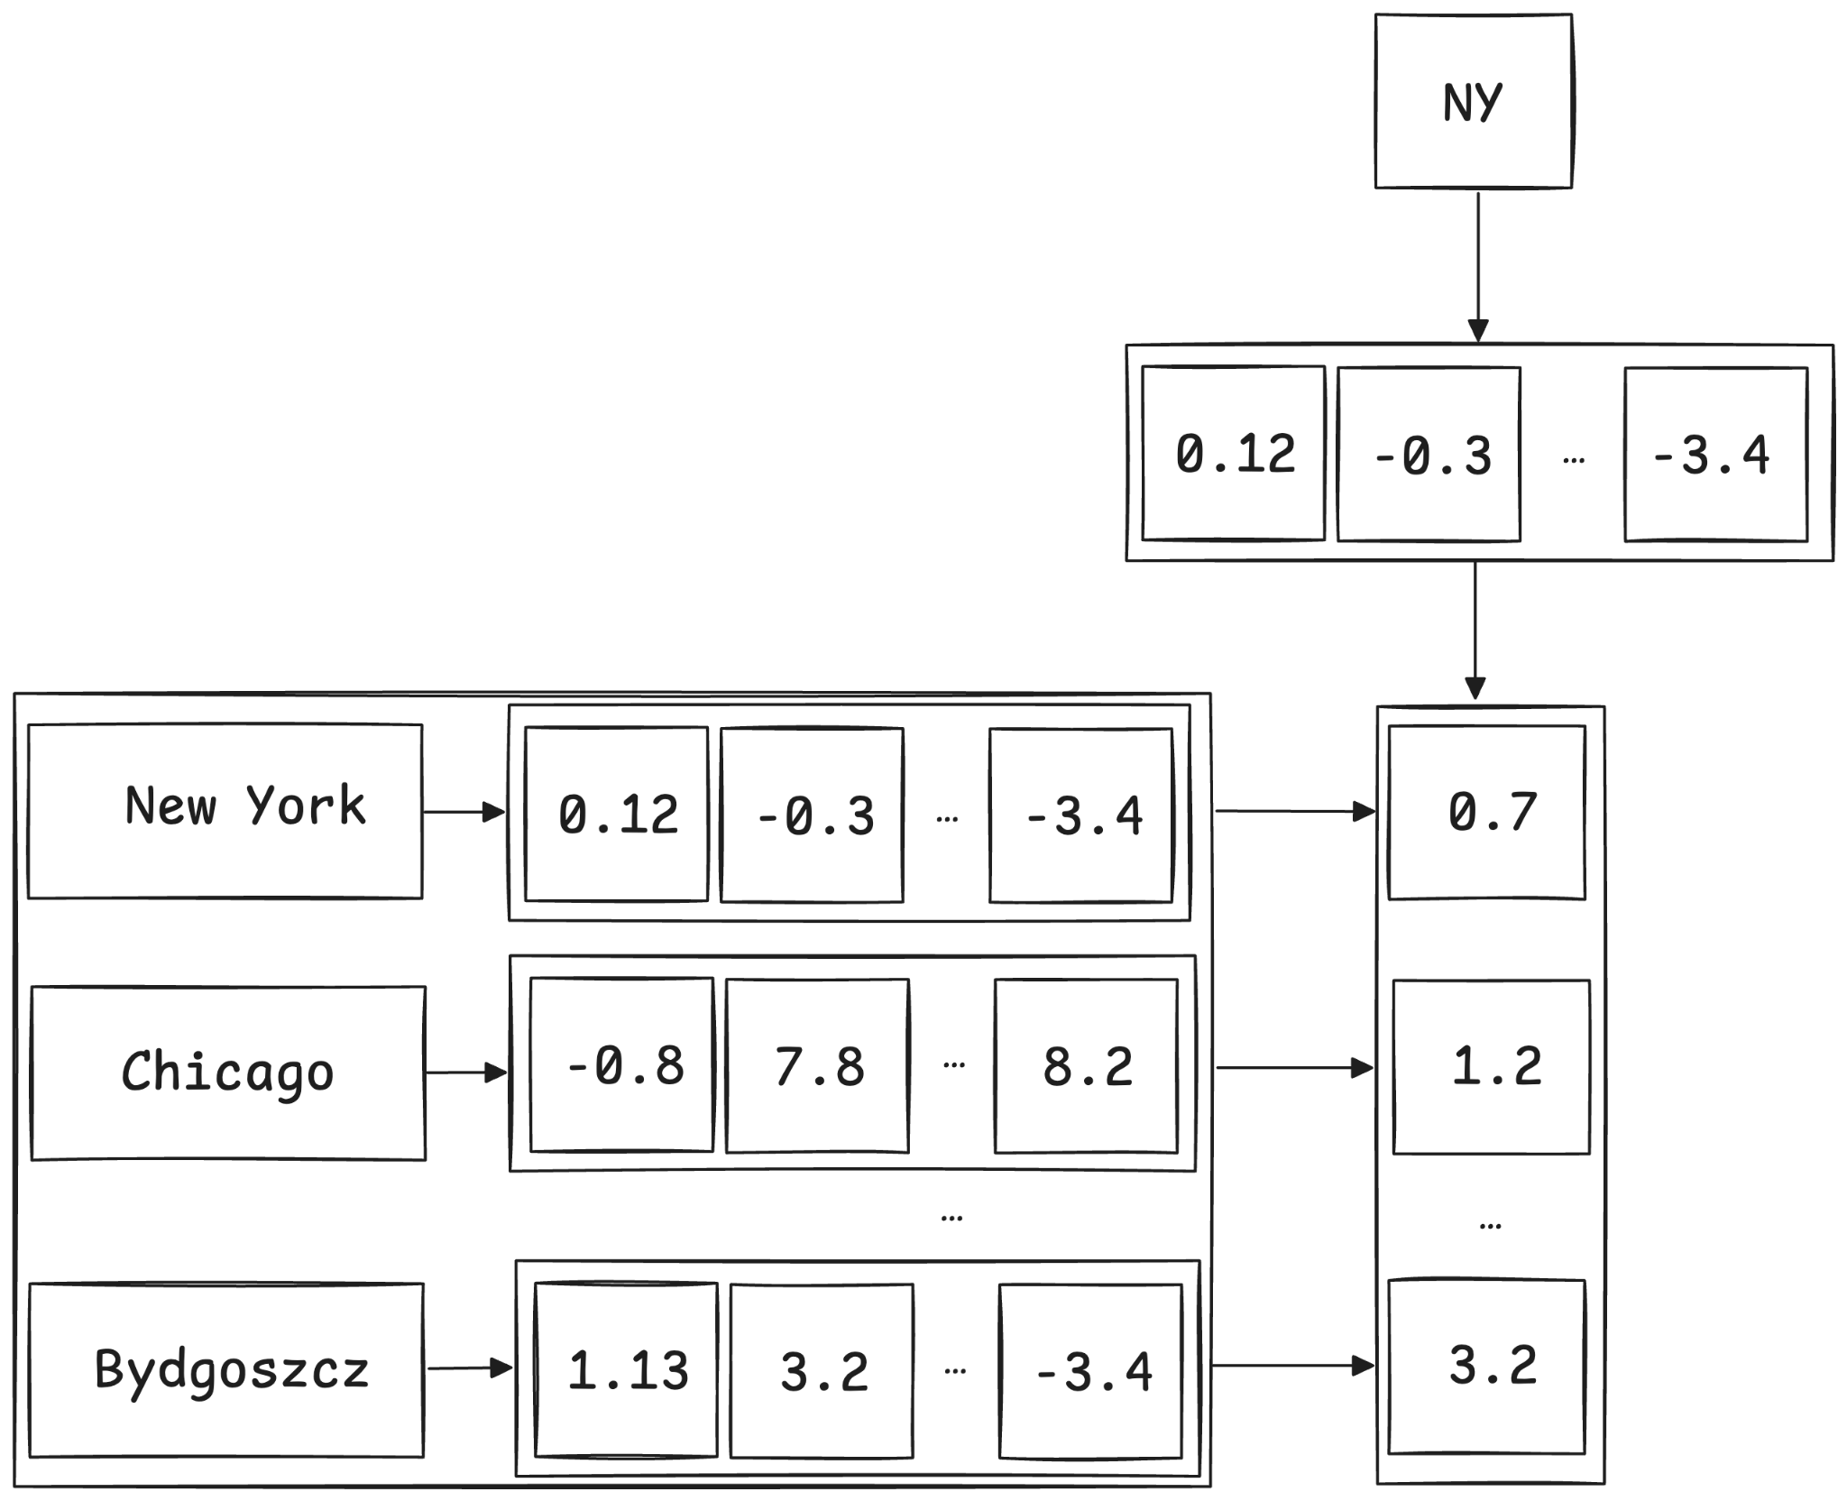
Constants in the query
Build an index from column values.
Extract constant values from an SQL.
Compare their embeddings with
a previously created index.
Replace each constant occurrences with a closest match.

Slide 22
Text-to-SQL problems
Generation of incorrect SQL queries (syntactically and semantically).
Lack of domain knowledge to handle more complex queries.
Risk of SQL injection and unauthorized data modification.
Incorrect handling of constant text values in queries.

Slide 23
Conclusion
Maybe LLMs shouldn't write SQL at all

Slide 24

Idea
Let the LLM query the database using pseudocode.
Declarative language which is a subset of Python.
Let the developer define pseudocode and build SQL in a deterministic way.
Build query in multiple steps, analyzing each aspect of the question.

Slide 25
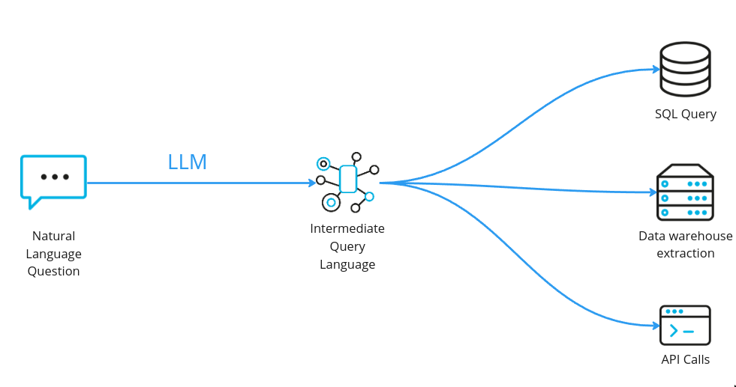
Intermediate Query Language

Slide 26
IQL syntax
Declarative function definitions as Python method signatures.
Simple function calls for query building.
Boolean operators for semantic functions calls chaining.
Special keywords for context injection.

Slide 27
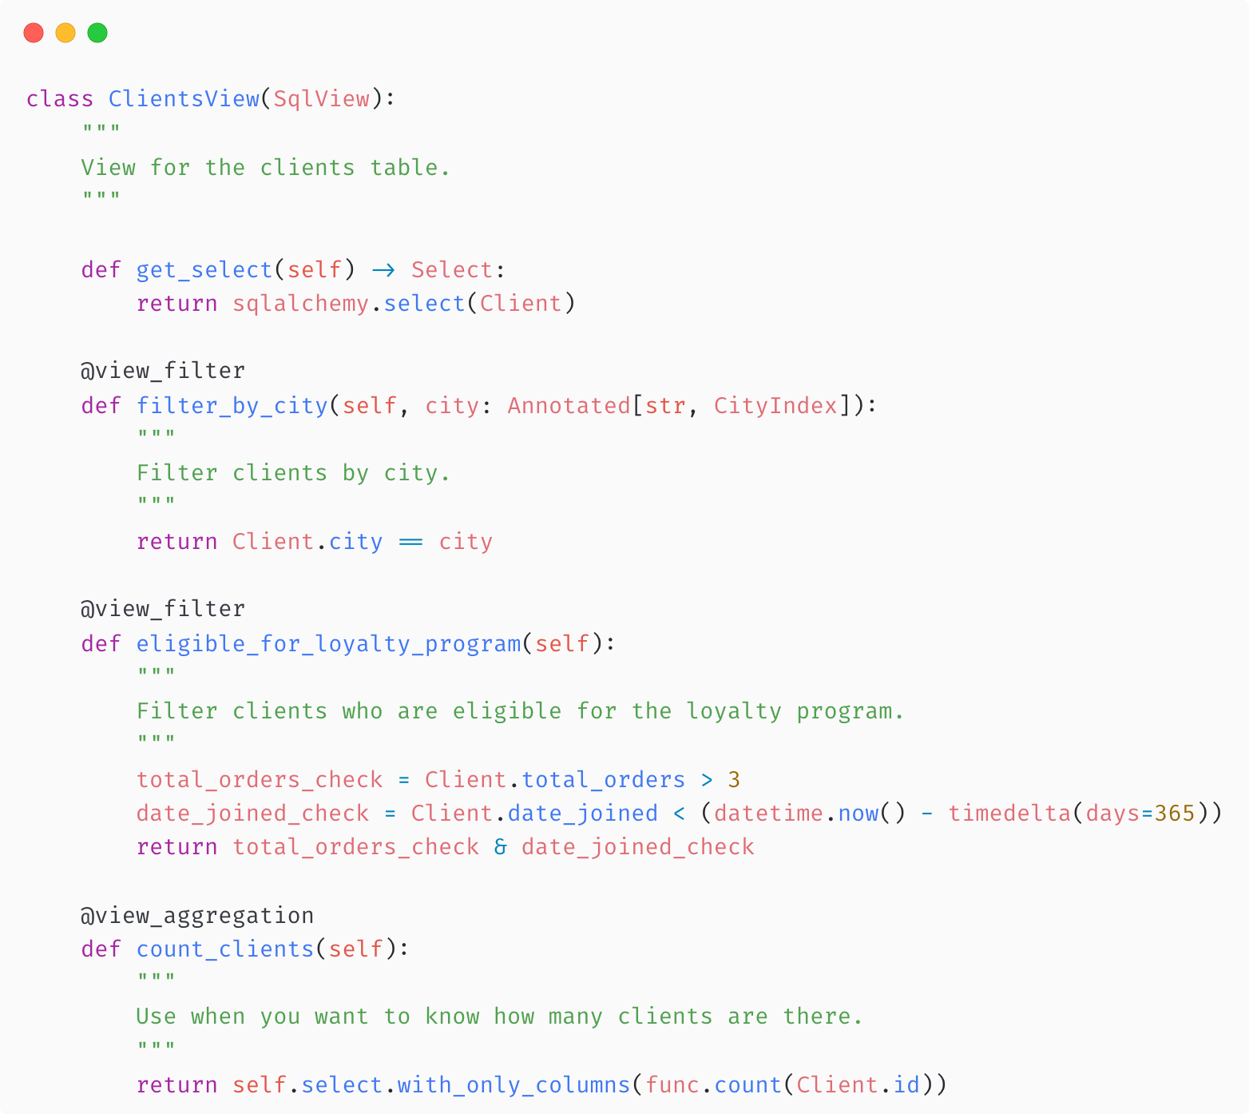
IQL frontend for developers

Slide 28
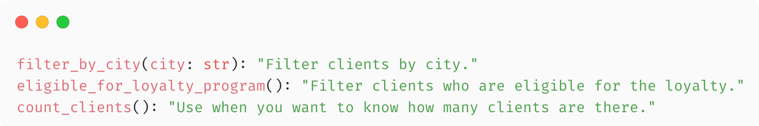
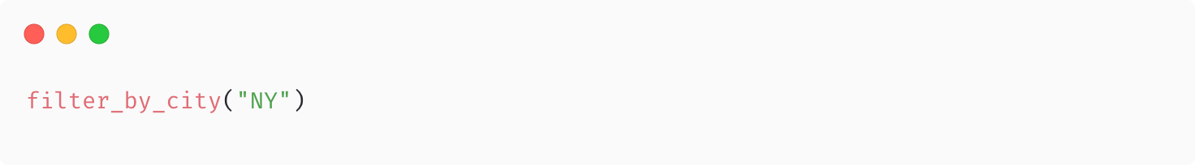
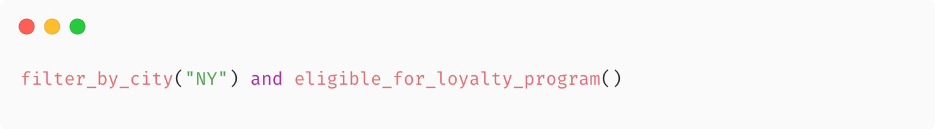
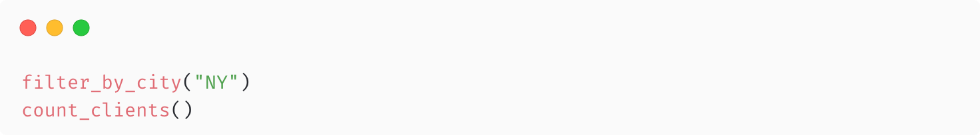
IQL frontend for LLM

Slide 29

IQL benefits
Similar questions can be grouped and handled by the same function call.
Well-known output schema, defined by developer.
Eliminates risk of SQL injection.
It is faster and cheaper to generate than SQL.
Natively encapsulates domain knowledge.
Agnostic to the underlying data source.

Slide 30
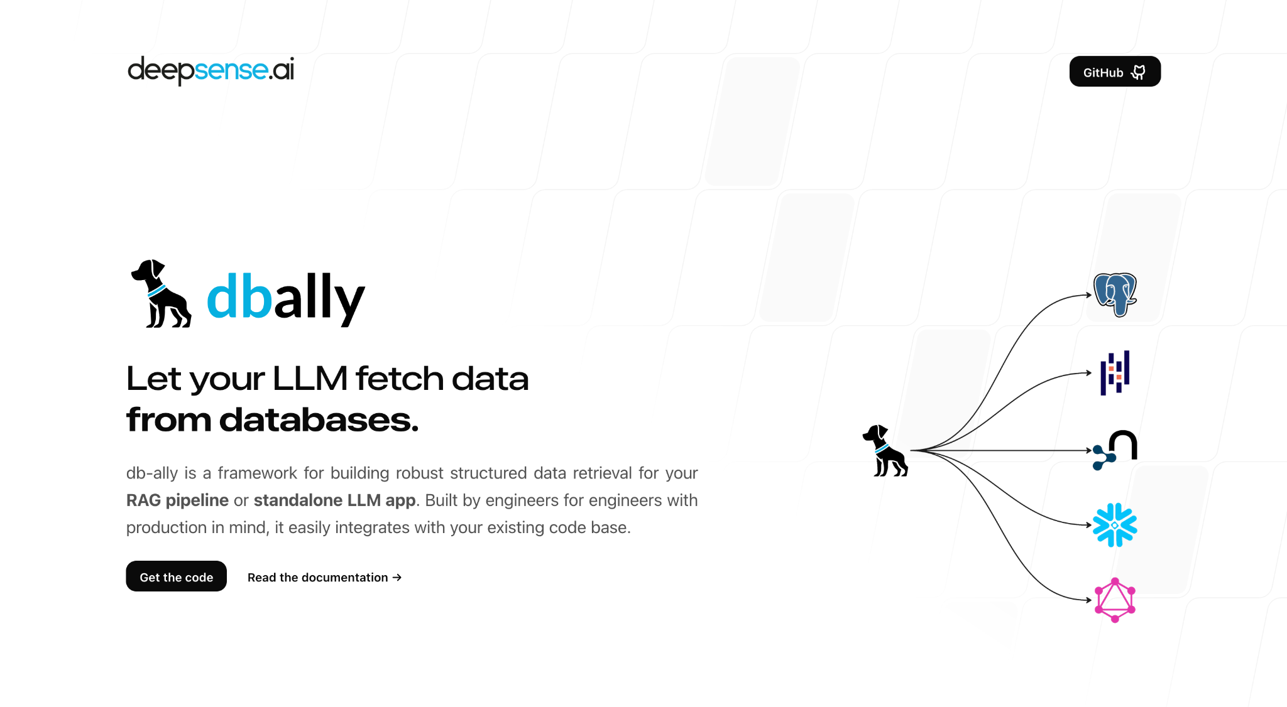
How to apply it?
db-ally official webpage - deepsense.ai/db-ally

Slide 31
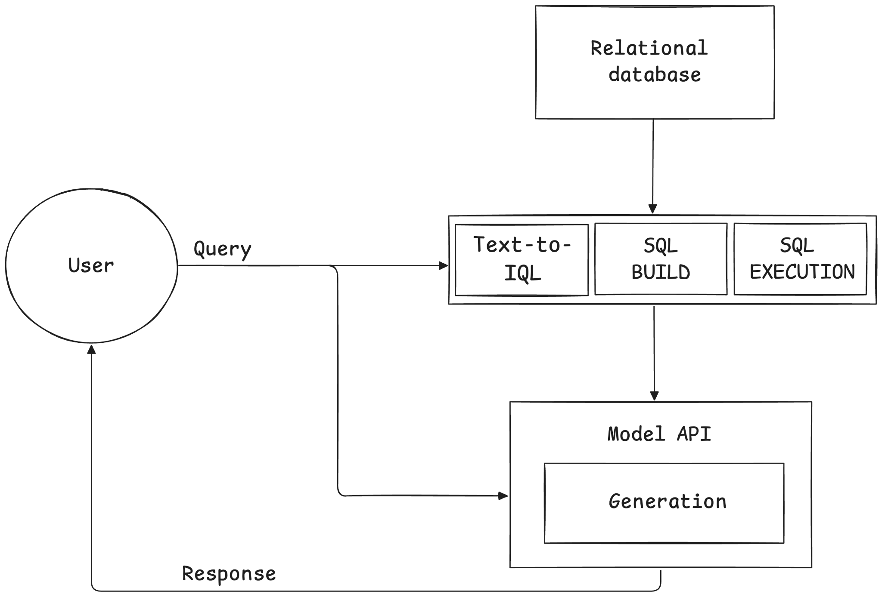
RAG with dbally
dbally

Slide 32
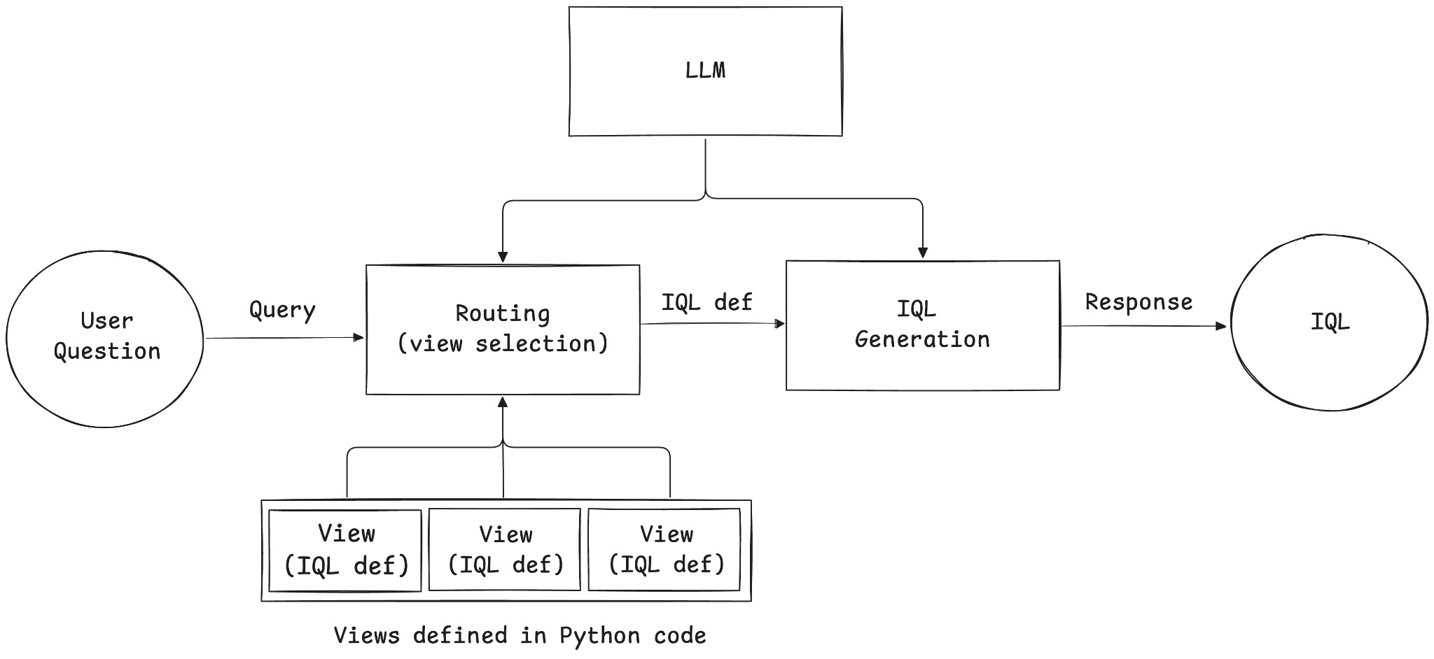
Text-to-IQL

Slide 33
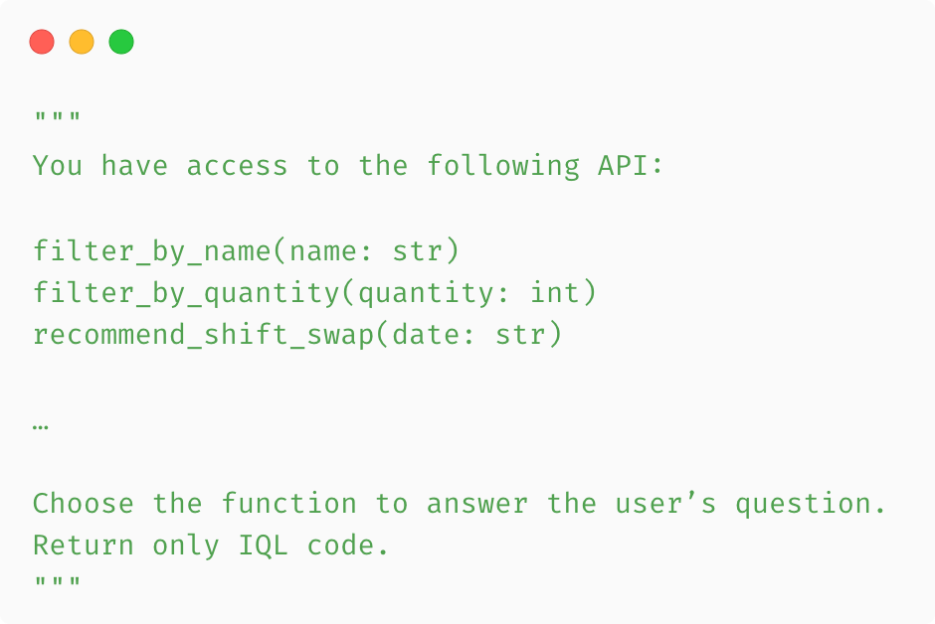
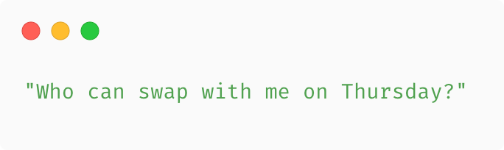
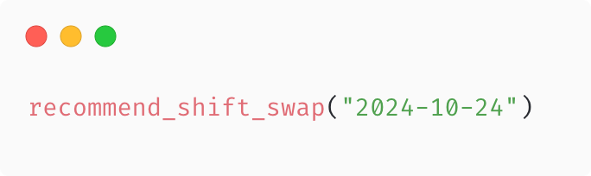
Text-to-IQL
SYSTEM
USER
ASSISTANT

Slide 34
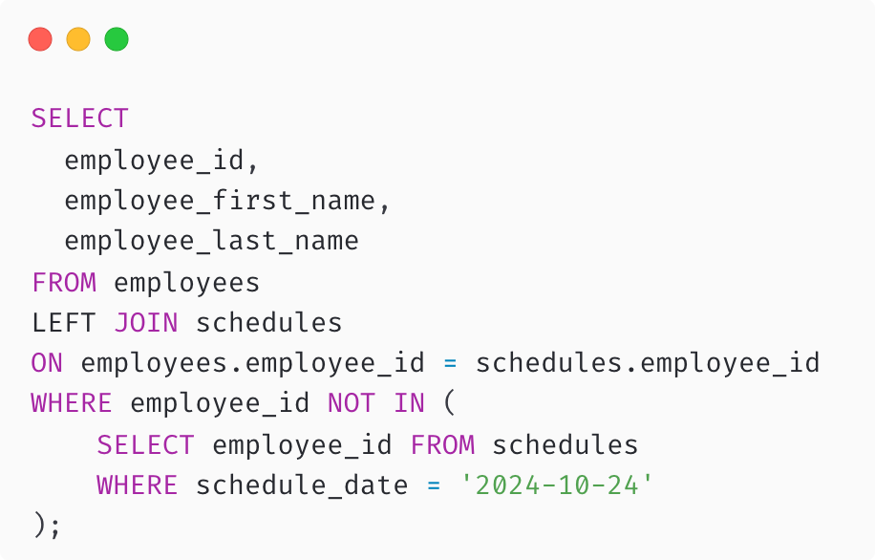
SQL build
IQL
SQL
ASSISTANT

Slide 35
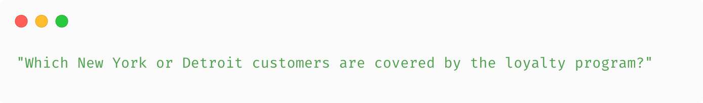
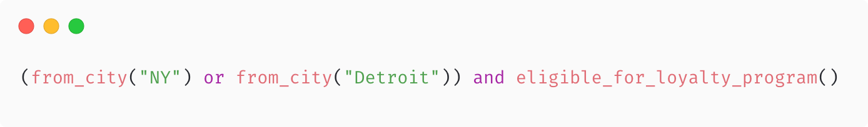
What if the question is more complex?
USER
ASSISTANT

Slide 36
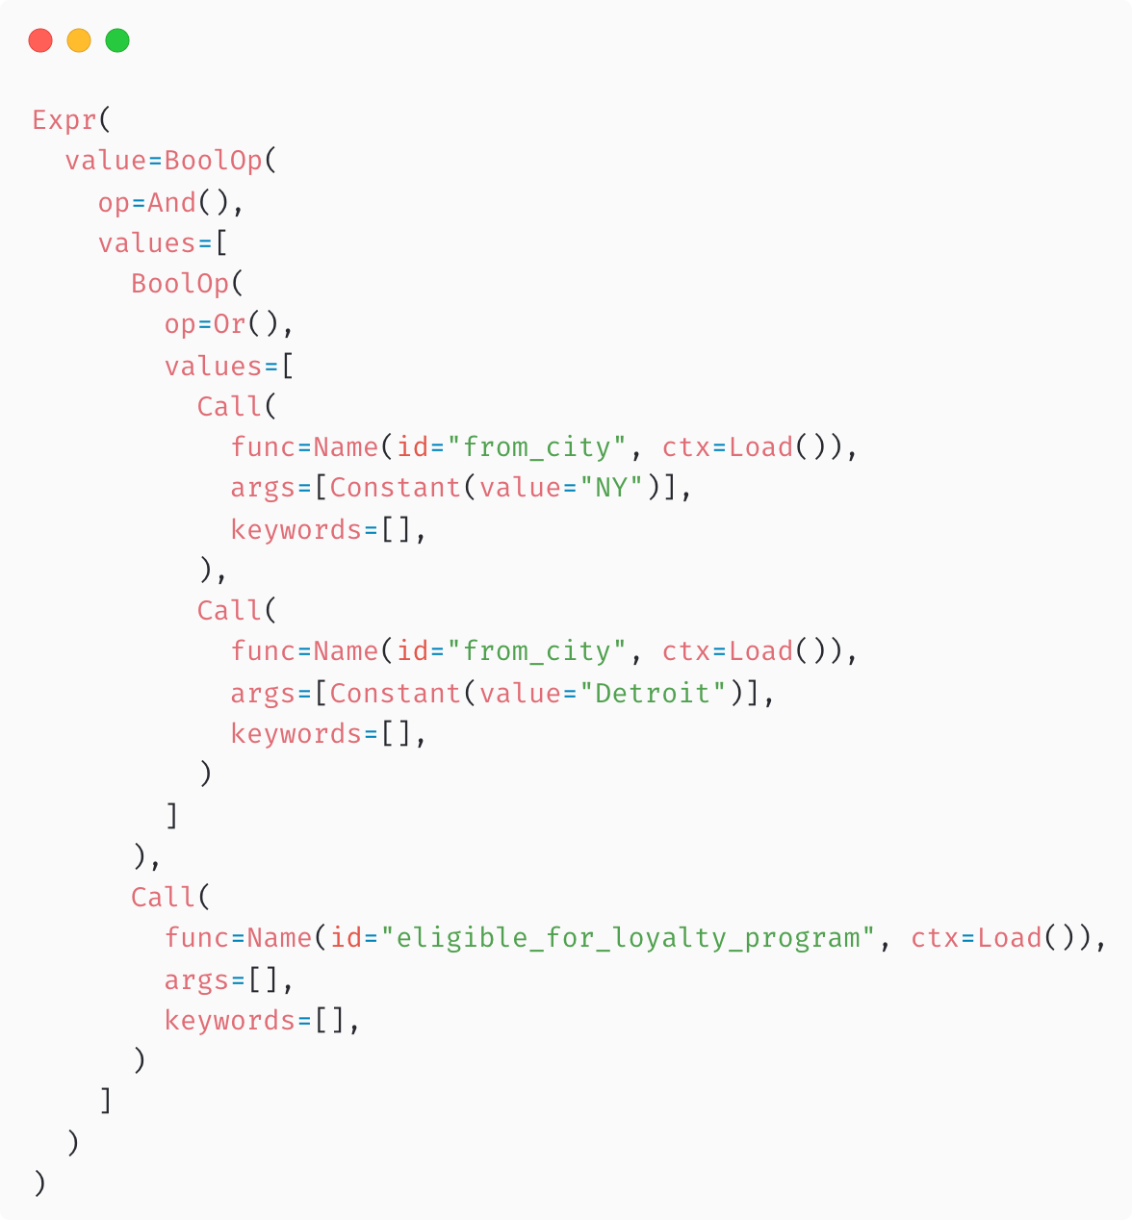
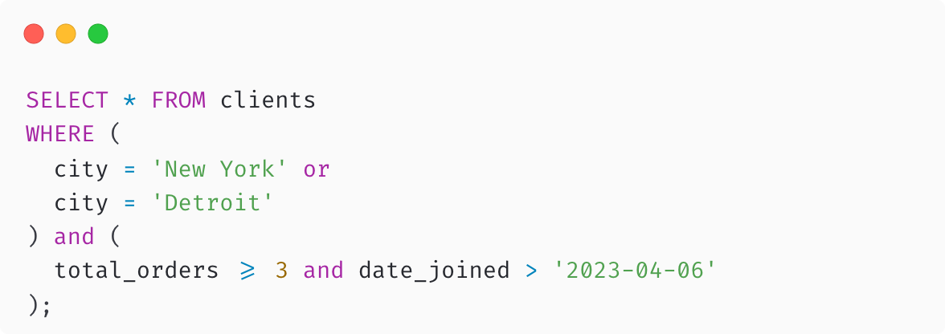
Building SQL from IQL syntax tree

Slide 37
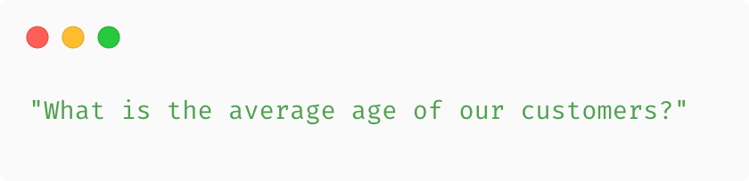
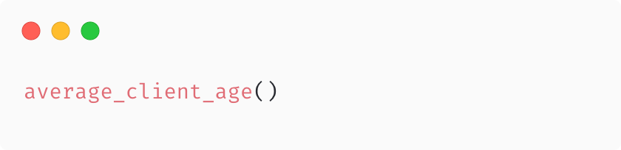
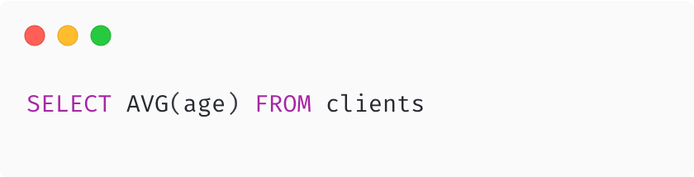
Analytical queries
USER
ASSISTANT
SQL

Slide 38
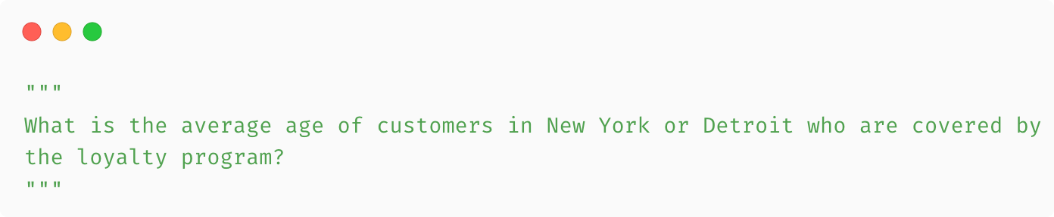
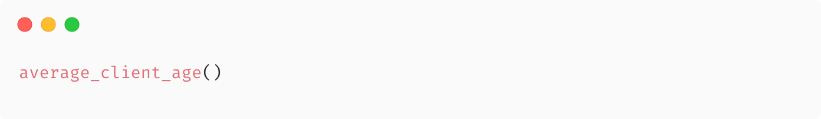
Complex queries
USER
ASSISTANT
ASSISTANT

Slide 39
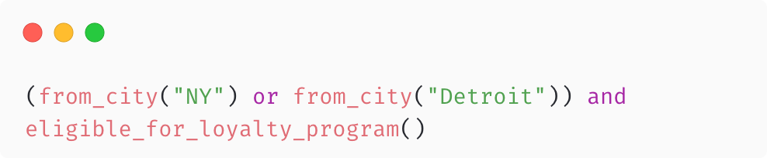
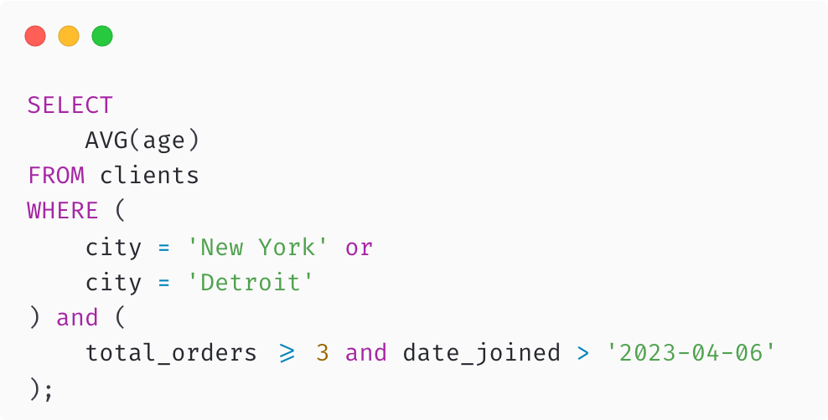
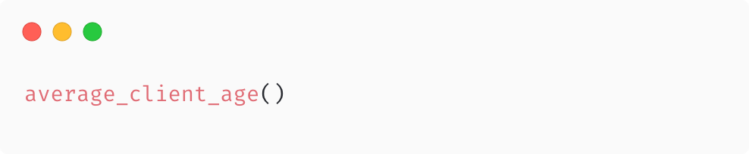
Complex queries
IQL
SQL

Slide 40
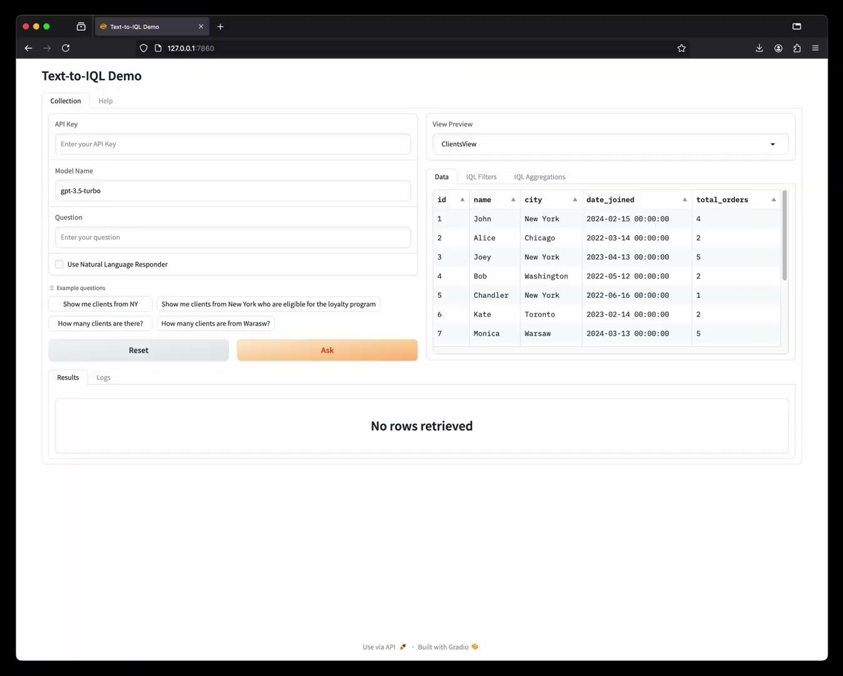
Demo

Slide 41




dbally is public
deepsense.ai/db-ally
db-ally.deepsense.ai
deepsense-ai/db-ally

Slide 42
Summary
RAG works better than the model itself.
RAG with structured data requires some form of Text-to-SQL.
Text-to-SQL is a difficult task for LLMs.
IQL solves the most painful problems associated with Text-to-SQL.
There is a trade-off between scalability and accuracy when choosing between Text-to-SQL and Text-to-IQL.

Slide 43
Thank you

Slide 44








SILVER SPONSOR
BRONZE SPONSORS
PARTNERS

